Slide 1
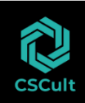
Managing the Cloud
Module Number: 05
Module Name: Managing the Cloud
Deepak Solanki
Div Head Cloud Team
CSCult

Slide 2
Managing the Cloud
AIM:
The aim of this module is to enable students understand the nuances of managing cloud.
2

Slide 3
Managing the Cloud
Objectives:
The Objectives of this module are:
Explain the important considerations when moving to cloud.
Explain designing a cloud proof of concept.
Discuss the risks and consequences of cloud computing.
3

Slide 4
Managing the Cloud
Outcome:
At the end of this module, you are expected to:
Outline the important considerations when moving to cloud.
Outline the important considerations when designing a cloud proof of concept.
Identify the risks and consequences of cloud computing.
4

Slide 5
Managing the Cloud
Contents
Managing and Securing Cloud Services
Virtualization and the Cloud
Managing Desktops and devices on the cloud
SOA and Cloud computing
Managing the Cloud environment
Planning for the Cloud—Economic Cost Model and Leveraging the Cloud
Cloud computing resources
Cloud Dos and Don’ts.
5

Slide 6
Managing the Cloud
Managing and Securing Cloud Services
6

Slide 7

Managing the Cloud
Managing the Cloud
Using a cloud model does not result in responsibility being given away for the corporate assets. Traditional security policies tend to assume a more static and controlled environment. Security, governance, and standards are all critical aspects the organizations should work to achieve. This module outlines what it takes to manage the cloud.
7

Slide 8


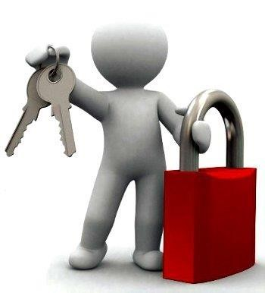
Managing the Cloud
Managing and Securing Cloud Services
Whether you are looking at creating a private cloud or leveraging a public cloud, you need to have a
security strategy. Without a secure environment never implement cloud computing.
The issues faced when using cloud are different than the traditional setup. You should make sure that
your IT security strategy is lined up with your cloud security strategy.
The security management provided by the cloud provider may or may not be compatible with the compliance and overall security of the company’s rules.
It is important to ensure the company’s information and technology security strategy to be integrated with the overall cloud computing strategy and plan.
8

Slide 9

Managing the Cloud
Managing and Securing Cloud Services
IT security is a very complicated area of cloud computing for three reasons:
You will be trusting your security to the cloud provider. If that provider has not done a good job
securing its own environment, you could be in trouble.
IT security is difficult to monitor and problems may not be apparent until something goes wrong.
Measuring the quality of a provider’s approach to security is difficult because many cloud
providers do not expose their infrastructure to customers.
An IT organization must ensure the right balance of protection, privacy, governance, and accessibility to key resources—whether in the traditional data center, the private cloud, or the public cloud. Security measures for monitoring access control, identity management, and the network need to be maintained
in a consistent way across the internal data center and hybrid cloud environments.
9

Slide 10


Managing the Cloud
Important Security Questions to be asked
To understand the importance of security from a cloud computing perspective, ask these most critical security questions to the potential cloud provider:
What is the cloud provider’s security architecture and policy?
Does the cloud provider use a third party to assess its own security risks?
Does the cloud provider understand its responsibilities for governance issues (such as cross-border data transfers)?
How comprehensive is the service-level agreement between you and the cloud provider?
Does the cloud provider understand your data preservation and protection needs?
Where does your data physically live? Do you have the cloud provider’s assurance that it will remain
private?
Does your cloud provider separate (partition) your data, applications, and/or management tools from other users of its cloud services?
Are there clear penalties for a data or system breach?
Is the data portability part of the service provided by the cloud vendor?
Does the cloud provider have a security baseline that it promises to adhere to?
10

Slide 11


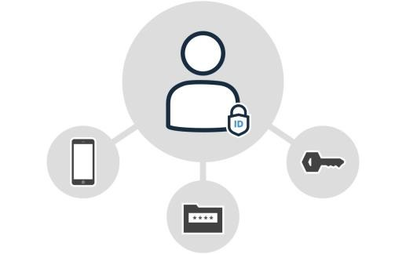
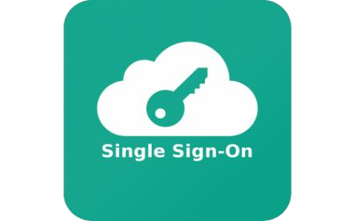
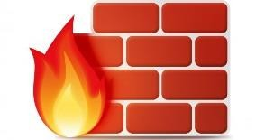
Managing the Cloud
Important Security Questions to be asked
Are you allowed to inspect the cloud facility?
Does your cloud provider have well implemented patch management policies and procedures?
Does the cloud provider have application level firewalls and other tools that help you keep your
application or code safe?
Can the cloud provider keep security information such as private keys private?
Does the cloud provider provide encryption and key management?
Does the cloud provider have a well-defined, well-executed identity and access management architecture?
Has single sign-on been implemented for the customers of a cloud provider?
11

Slide 12

Managing the Cloud
Understanding Cloud Security
Security risks, threats, and breaches can come in many forms and from many places; therefore, companies should take a comprehensive approach to security management across IT and the business.
For example, many companies use technology that tracks a person’s identity whether this person enters a company building or accesses corporate information, either from within the company’s perimeters or from any external location.
Companies should plan to secure IT environment focusing on a broad range of potential vulnerabilities to the data center, as well as ways to safeguard sensitive corporate, customer, and partner information wherever it is located.
When operating in cloud, the built-in application and data level protections such as authentication, authorization, and encryption may not be sufficient. As such, Security services at both the application and the infrastructure level must be a top consideration for organizations.
12

Slide 13
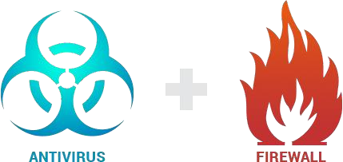
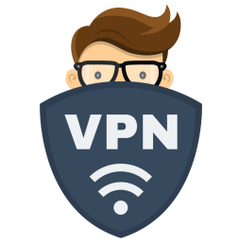
Managing the Cloud
Understanding Cloud Security
Point solutions usually cover specific vulnerabilities:
Firewalls protect the internal network from the Internet.
Antivirus software protects individual computers against known viruses.
VPNs protect external connections coming into the network.
These products reduce the risk of specific threats but are not an integrated approach to IT security. However, some important products can help build an integrated IT security platform.
They come in three categories:
Identity Management
Detection and forensics
Data Encryption
13

Slide 14
Managing the Cloud
Identity Management
14

Slide 15

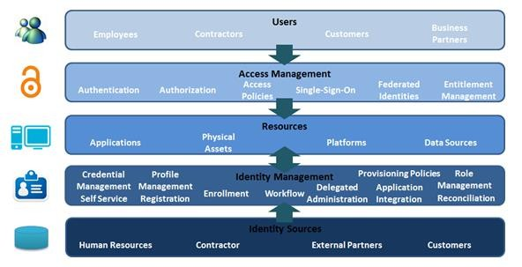
Managing the Cloud
Implementing Identity Management
The cloud is of sharing and virtualizing physical resources across many internal (and often external) users; therefore, it is essential to know who has access to what services.
Identity management’s primary goal is managing personal identity information so that access to computer resources, applications, data, and services is controlled properly.
15

Slide 16
Managing the Cloud
Benefits of identity management
Identity management helps prevent security breaches and plays a significant role in helping your company meet IT security compliance regulations.
The benefits of using identity management are:
Improved user productivity:
Productivity improvement comes from simplifying the sign-on interface and the ability to quickly change access rights. Productivity is likely to improve further where you provide user self-service.
Improved customer and partner service:
Customers and partners also benefit from a more streamlined, secure process when accessing applications and data.
Reduced help desk costs:
IT help desks typically experience fewer calls about forgotten passwords when an identity management process is implemented.
Reduced IT costs:
Identity management enables automatic provisioning—providing or revoking users’ access rights to systems and applications. Provisioning happens whether you automate it or not. When provisioning is manual, normally it is carried out by members of the IT operational staff or departmental staff. Considerable time and cost savings are possible when you automate the process.
16

Slide 17


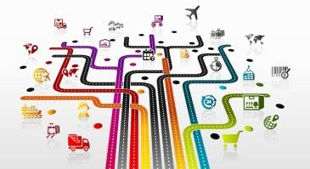
Managing the Cloud
Aspects of identity management
Corralling the data
Identity data generally are scattered around systems. Establish a common database or directory as a first step in gaining control of this information. This step involves inputting data to and gathering data from various user directories.
Integrating
An identity management system must integrate effectively with other applications. In particular, the system must have a direct interface to the following:
Human resources system, where new joiners and leavers are first recorded.
Supply-chain systems, if partners and suppliers use corporate systems.
Customer databases (if customers require access to some systems), although customer identity management normally is handled by a separate component of an identity management system.
17

Slide 18
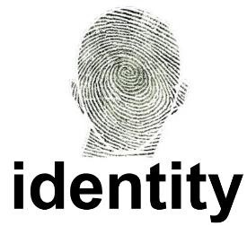



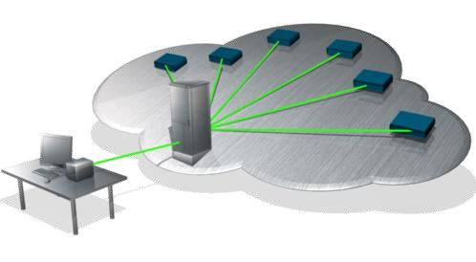
Managing the Cloud
Aspects of identity management
Beefing up authentication
When you require authentication stronger than passwords, the identity management system must
work with products that provide that authentication such as:
Biometric systems—fingerprints, handprints, iris verification
Identity token systems
Provisioning
When you link all systems that use identity information, you can automate provisioning. If this process is automated, a single status change of an employee or anyone else with access rights can be defined in the identity management system and sent across all affected systems from that point.
18

Slide 19
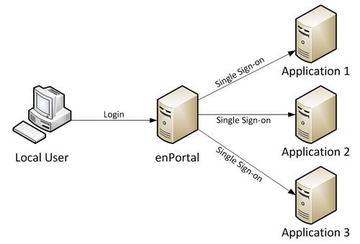
Managing the Cloud
Aspects of identity management
Single sign-on
Single sign-on means providing all users an interface that validates identity as soon as a user signs on anywhere; this interface requires the user to enter a single password. Thereafter, all systems should know the user and their permissions.
Instead of being assigned to individuals, permissions are often assigned to roles. Therefore, single sign-on also means capturing information about the administration hierarchy.
Single sign-on naturally goes with portal technology, with the user having a Web-based initial interface that provides access to all applications that he is entitled to access. Thus, single sign-on may need to interface with a portal product.
19

Slide 20


Managing the Cloud
Aspects of identity management
Security administration
Identity management reduces security administration costs because security administrators do not have to authorize manually.
The automatic ID management handling is particularly useful for organizations that have distributed security administration over several locations because it enables security administration to be centralized.
Analyzing data
After you centralize all user data, you can generate useful reports on resource and application use or carry out security audits.
For example:
If you are having problems with internal hacking, you can check a log that lists every user’s activity.
If you have logging software for databases and files, you can monitor who did what to any item of data and when, including who looked at specific items of data.
This audit capability is important for implementing data privacy and data protection compliance.
20

Slide 21
Managing the Cloud
Detection and Forensics
21

Slide 22
Managing the Cloud
Detection and Forensics
There should be a record of resources being accessed by intruder or legitimate user at all times.
The three important products under detection and forensics are:
Activity logs
Host-based intrusion protection systems (HIPS) and network-based intrusion protection
systems (NIPS)
Data audit
1. Activity logs
Many logging capabilities are included in operating systems, applications, databases, and devices
such as hardware firewalls and network monitors.
It costs to invoke logging capabilities: Turning on logs requires the system to write log records constantly, and it also involves managing and archiving such data until it is no longer needed.
Log files often provide some evidence of how fraud was perpetrated.
Perpetrators of digital fraud often escape justice simply because the victim does not have sufficient
evidence to prove what they did.
9

Slide 23
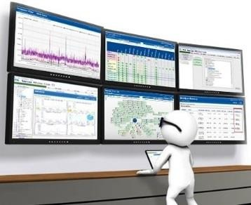


Managing the Cloud
Detection and Forensics
HIPS and NIPS
Host-based intrusion protection systems (HIPS) and network-based intrusion protection systems (NIPS) are the same thing: a collection of capabilities that make it tough to penetrate a network.
HIPS and NIPS can include the following elements:
System and log-file monitors:
This software looks for traces of hackers in log files. The monitors can watch login accounts and issue alerts when account permissions change—often an indication that something untoward is going on.
Digital deception software:
This software deliberately misleads anyone who is attempting to attack the IT network. It can range from the simple spoofing of various service names to setting up traps known as honeypots or honey nets.
9

Slide 24
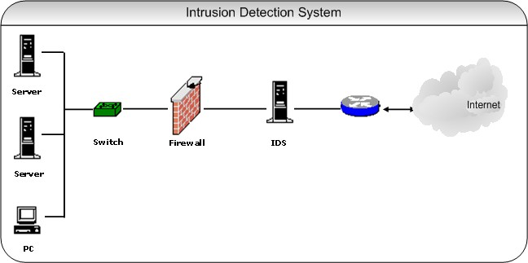
Managing the Cloud
Detection and Forensics
HIPS and NIPS
Network intrusion-detection systems (NIDS):
These security programs monitor data packets that travel through a network, looking for any telltale signs of hacker activity.
The effectiveness of a NIDS depends on whether it can sort real dangers from harmless threats and from legitimate activity.
An ineffective NIDS raises too many false alarms and, thus, wastes time.
9

Slide 25
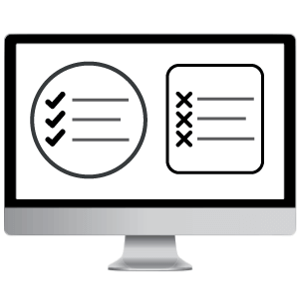
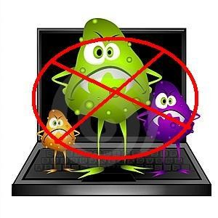
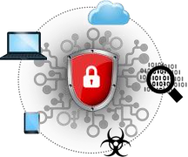
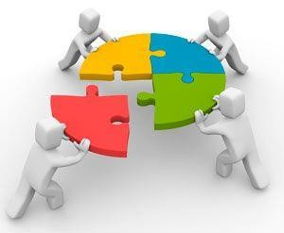
Managing the Cloud
Detection and Forensics
HIPS and NIPS
White-listing software:
This software inventories valid executable programs running on a computer and prevents any
other programs from running.
White listing severely hampers hackers, because even if they access a computer, they cannot upload their own software to run on it.
White-listing software reports on any attempt to run unauthenticated software. It also stops virus software stone dead.
Unified threat management:
This central function takes information from all the preceding components and identifies threats by analyzing the combined information.
9

Slide 26



Managing the Cloud
Detection and Forensics
Data audit
Although databases do log the name of the individual who changed the data, they normally do not log who read any piece of data. Read data can be easily stolen.
The Sarbanes-Oxley (SOX) legislation was enacted in 2002, specifically demanding that financial data be secured from unauthorized eyes.
The stated goal of SOX is, “To protect investors by improving the accuracy and reliability of corporate disclosures”.
A series of software products that log who looks at what quickly came into existence. These products generally are referred to as data audit products.
9

Slide 27
Managing the Cloud
Encrypting Data
27

Slide 28
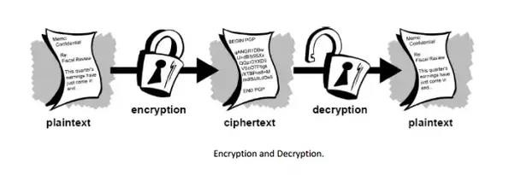
Managing the Cloud
Encrypting Data
There are a host of encryption techniques that are available and considered safe to use. Data can be encrypted so that only the intended recipient is able to decrypt it.
Data can be encrypted at rest as well as when in transit over the network reducing the risk of hackers stealing the data.
However, encryption can decrease performance; therefore, it is good to focus encryption on specific data that
needs protection.
9

Slide 29
Managing the Cloud
Virtualization and the Cloud
29

Slide 30
Managing the Cloud
Virtualisation
Virtualization is essential for cloud computing. In fact, cloud computing is very difficult without virtualization. In Unit 2, we have studied virtualization and it characteristics. Lets briefly recall it here.
Virtualization is using computer resources to imitate other computer resources or whole computers.
The forms of virtualization are:
Virtual memory
Software
Cloud computing needs to support many different operating system environments, it requires a hypervisor. A hypervisor is an operating system, which means that it knows how to act as a traffic cop to make things happen in an orderly manner. The hypervisor sits at the lowest levels of the hardware environment.
9

Slide 31
Managing the Cloud
Virtualization
What makes virtualization important for cloud?
Virtualization decouples the software from the hardware.
Decoupling means that software is put in a separate container so that it is isolated from operating systems.
Applications
Virtualization can be applied very broadly to just about everything that you could imagine:
Memory
Networks
Storage
Hardware
Operating systems
Applications
9

Slide 32
Managing the Cloud
Virtualisation
Hardware abstraction and management:
Virtualization abstracts hardware assets allowing a single piece to be used for multiple tasks. Hardware abstraction results in:
File system virtualization:
Virtual machines can access different file systems and storage resources via a common interface.
Virtual symmetric multiprocessing:
A single virtual machine can use multiple physical processors simultaneously and thus pretend to be a
server cluster. It also can emulate a fairly large grid of physical servers.
Virtual high-availability support:
If a virtual machine fails, that virtual machine needs to automatically restart on another server.
9

Slide 33
Managing the Cloud
Virtualization
Hardware abstraction and management:
Distributed resource scheduler:
You could think of the scheduler as being the super-hypervisor that manages all the other hypervisors. This mechanism assigns and balances computing capability dynamically across a collection of hardware resources that support the virtual machines. Therefore, a process can be moved to a different resource when it becomes available.
Virtual infrastructure client console:
This console provides an interface that allows administrators to connect remotely to virtual center management servers or to an individual hypervisor so that the server and the hypervisor can be managed manually.
9

Slide 34
Managing the Cloud
Managing Virtualization
Foundational Issues
Business Considerations
Provisioning Software
Virtualizing Storage
Hardware Provisioning
Security Issues
9

Slide 35
Managing the Cloud
Managing Virtualization
For cloud computing to operate consistently, the service provider has to track all the virtualized resources. The service provider must keep track of
Where everything is
What everything has to accomplish
For what purpose
Foundational Issues:
Managing a virtual environment involves some foundational issues that determine how well the components
function as a system. These issues include:
How licenses are managed
How workloads are controlled
How the network itself is managed
9

Slide 36
Managing the Cloud
Foundational Issues
36

Slide 37
Managing the Cloud
Managing Virtualization
Foundational Issues:
License management:
Many license agreements tie license fees to physical servers rather than to virtual servers. Resolve these licenses before using the associated software in a virtual environment. The constraints of such licenses may become an obstacle to the efficiency.
Service levels:
Measuring, managing, and maintaining service levels can become more complicated simply because the environment itself is more complex. When cloud computing is added in to the mix, the cloud consumer is responsible for establishing service levels for both internally virtualized environments as well as those living in the cloud.
Network management:
The real target of network management becomes the virtual network, which may be harder to manage
than the physical network.
9

Slide 38
Managing the Cloud
Managing Virtualization
Foundational Issues:
Workload administration:
Set policies to determine how new resources can be provisioned, and under what circumstances. Before a new resource can be introduced, it needs to be approved by the management. Also, the administrator has to be sure that the right security policies are included.
Capacity planning:
All servers do not deliver the same capacity. With virtualization, you have more control of hardware
purchases and can plan network resources accordingly.
9

Slide 39
Managing the Cloud
Business Considerations
39

Slide 40

Managing the Cloud
Managing Virtualization
Important Business Considerations:
A business can use virtualized storage for backup, recovery, and disaster recovery. Virtualized storage can reinforce or replace existing backup and recovery capabilities. It can also create mirrored systems (duplicates of all system components) and, thus, might participate in disaster-recovery plans. This issue must be resolved both for internally virtualized environments as well as for those leveraging external clouds.
A service provider or a business investing in its own private cloud can perform backups of whole virtual
machines or collections of virtual machines in any given state as disk files.
A business leveraging virtualization for a private cloud or a service provider, must manage the service levels of the applications running in a virtualized environment. The actual information delay from disk varies for data held locally, data held on a storage area network (SAN), and data held on network access storage (NAS), and the delay differences may matter. Test different storage options against service levels.
In the long run, establish capacity planning to support the likely growth of the resource requirement for
9
any application (or virtual machine).

Slide 41


Managing the Cloud
Managing Virtualization
Provisioning software
Provisioning software allows to create new virtual machines and modify existing ones to add or reduce resources. It enables the management to prioritize actions based on company’s key performance indicators.
It enables the following:
Migration of running virtual machines from one physical server to another
Automatic restart of a failed virtual machine on a separate physical server
Clustering, or grouping, of virtual machines across different physical servers
Hardware Provisioning
Provisioning is the act of allocating a virtual machine to a specific server from a central console.
9

Slide 42
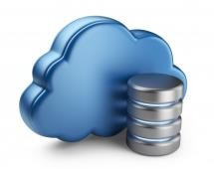
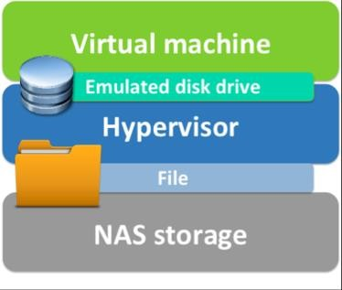
Managing the Cloud
Managing Virtualization
Virtualizing storage
Organizations also need to virtualize storage. In addition to application data, virtual machine images need to be stored.
When virtual machines are not in use, they are stored as disk files that can be instantiated at a moment’s notice.
This currently works for Network-Attached Storage (NAS) rather than Storage Area Network (SAN)
because a NAS is less expensive and more flexible than a SAN.
9

Slide 43
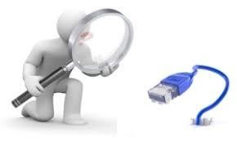
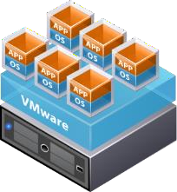
Managing the Cloud
Managing Virtualization
Security issues
Using virtual machines complicates IT security because it involves protecting virtual machines (or collections of them). Some of the issues are:
Network monitoring
Current network defenses are based on physical networks. In the virtualized environment, the network is no longer physical; its configuration can actually change dynamically, which makes network monitoring difficult. To fix this problem, you must have software products (available from companies such as VMWare, IBM, Hewlett-Packard, and CA) that can monitor virtual networks and, ultimately, dynamic virtual networks.
Hypervisors
Just as an OS attack is possible, a hacker can take control of a hypervisor. If the hacker gains control of the hypervisor, he gains control of everything that it controls; therefore, he could do a lot of damage.
9

Slide 44

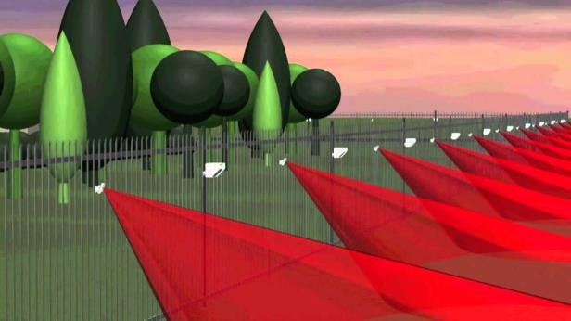
Managing the Cloud
Managing Virtualization
Security issues
Configuration and change management
The simple act of changing configurations or patching the software on virtual machines becomes much more complex if the software is locked away in virtual images; in the virtual world, you no longer have a fixed static address to update the configuration.
Perimeter security
Providing perimeter security, such as firewalls, in a virtual environment is a little more complicated than in a normal network because some virtual servers are outside a firewall. This will be the responsibility of the service provider.
9

Slide 45
Managing the Cloud
Managing Desktops and Devices on the Cloud
45

Slide 46
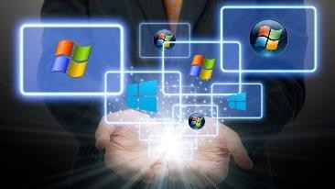
Managing the Cloud
Virtual Desktops
In a virtualized desktop, the applications, data, files, and anything graphic are separated from the actual desktop and stored on a server in a data center (not on the individual machine). A virtual desktop is also called graphic terminal or a thin client.
Virtualizing the desktop can bring down the Total Cost of Ownership (TCO).
A PC’s total cost of ownership (TCO): acquisition, maintenance, support, help desk, hardware, software,
and power.
In a typical enterprise situation, the annual support cost per PC is anywhere between three and five times the cost of the PC itself.
Standardizing infrastructure that needs to be managed via virtualization makes it easier to optimize IT
resources.
Virtualization is popular in a number of industries. For example,
In healthcare, clinicians use a virtualized desktop to gain access to information in any patient room.
In science labs, where space is at a premium and contaminant-free work areas are a priority, virtualized desktops eliminate the server and other hardware from the room.
Temporary workers and traders who are moving constantly.
9

Slide 47
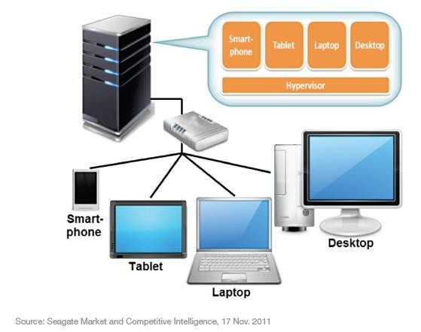
Managing the Cloud
Virtual Desktops
9

Slide 48

Managing the Cloud
The client desktop
Client virtualization involves emulating a whole PC in software on a data center server and displaying the user interface on a graphics terminal.
Virtualizing the client desktop can happen in four ways, each of which is described in the following sections:
Session-based computing
Operating-system streaming
Virtual Desktop Infrastructure (VDI)
PC blade
Session-based computing
In session-based computing, the user is really running a session on a server. The server is running a single instance of the Windows operating system with multiple sessions. Only the screen image is actually transmitted to the user, who may have a thin client or possibly an old PC.
Products that provide this capability include Citrix MetaFrame and Microsoft Terminal Services.
9

Slide 49


Managing the Cloud
The client desktop
Operating-system streaming
In this approach, the Windows OS software is passed to the client device—but only as much of the software that’s needed at any point in time. Technically, this process is called streaming. Some of the processing occurs on the disk and some in local memory. Thus, the Windows OS and its applications are split between the client and the server. Streaming applications run at about the same speed as reading the application from the disk.
Virtual Desktop Infrastructure
Virtual PCs are created on the server. The user has what appears on the server to be a complete PC. The graphics are being sent to a desktop. Today, most people refer to this kind of client virtualization as Virtual Desktop Infrastructure (VDI).
VDI is the ability to have shared client sessions on the server rather than on the client. The software you need to use sits on the server and an image can be viewed on your device. It is a type of virtualization hosted on the server. It is widely used and appropriate in many client environments.
9

Slide 50
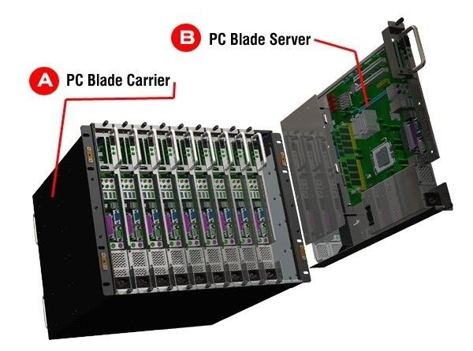
Managing the Cloud
The client desktop
The PC blade
A server blade is a server computer contained entirely on a single computer board that can be slotted into a blade cabinet—a purpose-built computer cabinet with a built-in power supply. The server blade can contain a number of PC blades.
Each user is typically associated with one PC blade—although some environments let multiple users share one PC blade—and a whole PC sits on a server blade in the data center. Normally, the desktop is a thin client.
9

Slide 51

Managing the Cloud
Virtual Desktops in the Cloud
The two big advantages of moving desktops to the cloud are:
You can create desktops at your own speed. The PC blades or VDI servers are located at the provider’s data center. You pay the provider a fee for this.
The average deployment time for a server in a data center is about five days. This includes all the setup and provisioning of the server. You might get 5–10 virtual servers from this. If your resources are in the cloud, and the provider already has the infrastructure and management software ready for you to set up these desktops, your provisioning time might be five seconds.
This means, for example, that you decide when you want to provision the HR department—you can do it all at once, or over the course of a month—it is at your own speed.
You can get as many resources as you need for these desktops. And, if the HR department needs more resources, the cloud provider has them ready, as well. Say you have offices in New York and Hong Kong, when the New York office is dark and everyone is asleep, you can use the same resources for Hong Kong because of the virtualization on the back end.
9

Slide 52
Managing the Cloud
Virtual Desktops in the Cloud
Business advantages:
The upfront investment is very low and transforms most client computing costs from fixed to variable.
It is quick to deploy and easy to scale incrementally.
It is particularly attractive to companies that are running out of data center space.
9

Slide 53
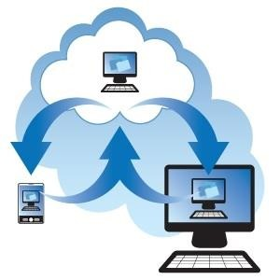
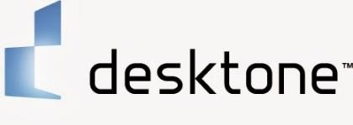
Managing the Cloud
Desktop as a Service (DaaS)
Desktop as a Service is a new class of services that help deploy and manage the virtual desktops. The two main players here are:
Desktone
Virtual Bridges
Desktone (www.desktone.com) offers what it calls the Desktone Virtual-D Platform, which is a unified desktop virtualization platform. It actually integrates discrete virtualization technology (application, network, etc.) and allows the whole thing to be managed from a single console.
The platform is two tiered:
Enterprise: The enterprise manages the operating system, applications, and licensing.
Service provider: The physical data center infrastructure is run by service providers using a VDI model.
Desktone provides a virtual desktop grid—what it calls an access fabric. This fabric is a software service
that manages desktop virtualization.
9

Slide 54
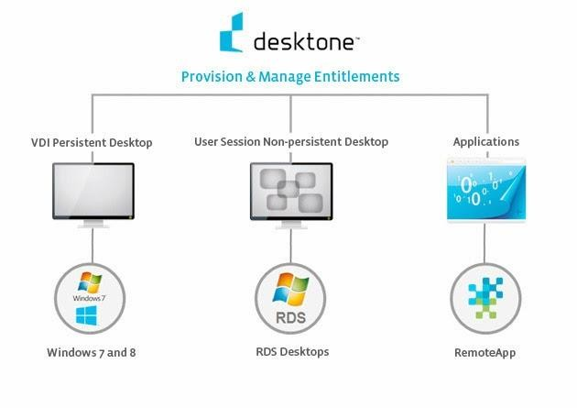
Managing the Cloud
Desktop as a Service (DaaS)
9

Slide 55
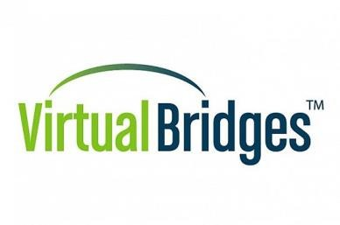
Managing the Cloud
Desktop as a Service (DaaS)
2. Virtual Bridges
Virtual Bridges (www.vbridges.com) was established in 2000 to create VDI on Linux servers. It offers Virtual Enterprise Remote Desktop Environment (VERDE), which is a desktop virtualization solution for Linux and Windows that use VDI.
It recently partnered with IBM and others to offer SMART, a business cloud computing strategy. This solution runs open standards-based email, word processing, spreadsheets, unified communication, social networking, and other software to any laptop, browser, or mobile device from a virtual desktop login on a Linux-based server configuration. The solutions combine VERDE with the Ubuntu desktop Linux OS from Canonical (www.canonical.com) and IBM’s collaboration and productivity software.
9

Slide 56
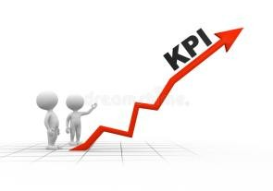
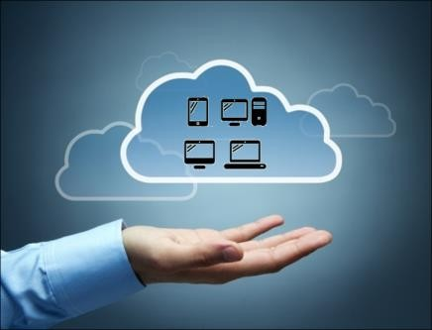
Managing the Cloud
Managing Desktops in the Cloud
In terms of managing desktops in the cloud, you need to monitor at least two key performance indicators
(KPIs) regardless of the model you choose:
Annual support costs per device: This metric is preferable to the total cost of ownership, which includes
variable uncontrollable costs such as software licenses and device purchases.
Availability: This metric, which measures uptime, should be close to 100 percent with virtualized cloud desktops.
Even if the desktops move to the cloud, there is a need for keeping track of your assets, as well as monitoring how your services are running.
9

Slide 57


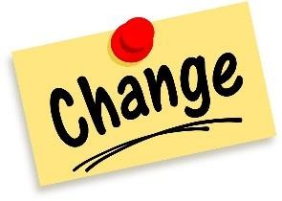
Managing the Cloud
Managing Desktops in the Cloud
The five areas that should be kept tracked irrespective of the cloud model chosen:
Asset management:
No matter what the client environment is (cellphone, BlackBerry, thin client, etc.), activities within that container need to be registered, monitored, and tracked based on both the hardware itself, the software that runs on the platform, and how various groups use it.
Service monitoring:
Activities in this process area monitor what is happening at each client, as well as the tasks required to maintain the right level of service. The service desk provides coordination for monitoring.
Change management:
Activities in this process area involve managing and implementing all changes in applications and hardware. Although you may often be working off a golden image, this is still important.
A golden image means that every user will have the identical environment. If something goes wrong, an administrator simply gives that user a new copy of the same image so that there is less management needed for each individual desktop user.
9

Slide 58


Managing the Cloud
Managing Desktops in the Cloud
Security:
Activities in this process area involve securing the whole client domain against external threats and authenticating which user can get into which facilities.
Governance:
Cloud services need to be considered in connection with your governance strategy and your ability to comply with industry and government regulations (like Sarbanes-Oxley, Health Insurance Portability and Accountability Act, and Payment Card Industry Security Standards).
For example, desktops in the cloud allow for all types of data to pass through and be stored. You need a
plan to ensure continued compliance with regulations.
9

Slide 59
Managing the Cloud
Service-Oriented Architecture and the Cloud
59

Slide 60
Managing the Cloud
Service Oriented Architecture and the Cloud
A service-oriented architecture is essentially a collection of services. These services communicate with each other. The communication can involve either simple data passing or it could involve two or more services coordinating some activity.
One of the key benefits of a service oriented approach is that the software is designed to reflect best practices and business processes instead of making the business operate according to the rigid structure of a technical environment.
Cloud services benefit the business by taking best practices and business process focus of SOA to the next level. These benefits apply to both cloud service providers and cloud service users. Cloud service providers need to architect solutions by using a service-oriented approach to deliver services with the expected levels of elasticity and scalability.
A service-oriented architecture (SOA) is a software architecture for building business applications that implement business processes or services through a set of loosely coupled, black-box components orchestrated to deliver a well-defined level of service.
9

Slide 61
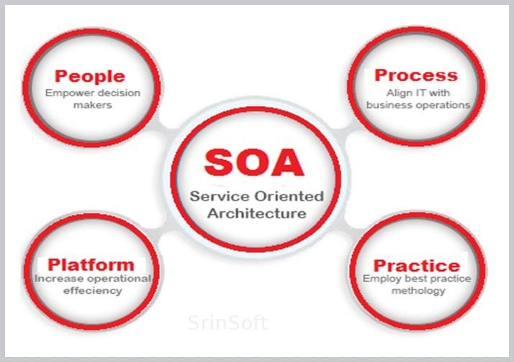
Managing the Cloud
Service-Oriented Architecture and the Cloud
9

Slide 62
Managing the Cloud
Characterizing SOA
The principal characteristics of SOA are:
SOA is a black-box component architecture. The black box lets you reuse existing business applications; it simply adds a fairly simple adapter to them. You need not know every detail of what is inside each component. SOA hides the complexity whenever possible.
SOA components are loosely coupled. Software components are loosely coupled if they are designed to interact in a standardized way that minimizes dependencies. One loosely coupled component passes data to another component and makes a request; the second component carries out the request and, if necessary, passes the data back to the first. Each component offers a small range of simple services to other components.
SOA components are orchestrated to link through business processes to deliver a well-defined level of service. SOA creates a simple arrangement of components that, together, deliver a very complex business service. Simultaneously, SOA must provide acceptable service levels. To that end, the components ensure a dependable service level. Service level is tied directly to the best practices of conducting business, commonly referred to as business process management (BPM)—BPM focuses on effective design of business process and SOA allows IT to align with business processes.
9

Slide 63
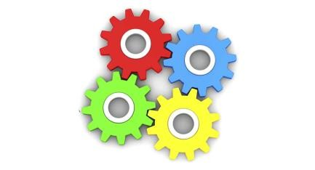
Managing the Cloud
Fundamentals of SOA Components
The Enterprise Service Bus (ESB) makes sure that messages get passed back and forth between the components of an SOA implementation.
The SOA Registry and Repository have important reference information about where the SOA business services are located.
The Business Process Orchestration Manager provides the technology to connect people to people,
people to processes, and processes to processes.
The Service Broker connects services to services, which in the end enables business processes to flow.
The SOA Service Manager makes sure that the technology underneath the SOA environment works in a consistent, predictable way.
Each component has a role to play, both independently and with each other. The goal is to create an environment where all these components work together to improve the business process flow.
9

Slide 64
Managing the Cloud
Fundamentals of SOA Components
Business Process Orchestration Manager
Business Process Layer
Business Apps 1
F1 F2 F3
Business Function 1
Enterprise Service Bus
SOA
Registry
Infrastructure Services
Service Broker
SOA Service Manager
9

Slide 65
Managing the Cloud
Managing the Cloud Environment
65

Slide 66

Managing the Cloud
Managing the Cloud
When leveraging cloud services, you should have a clear understanding of how that resource will be managed by the provider.
The provider has to manage the underlying infrastructure along with its multitude of other customers. This
includes the physical servers, networks, and storage, as well as any virtual servers.
The databases and applications that are running on top of this infrastructure also should be managed but for the most part of this you are not in control.
The cloud is a complex environment and many parties may be part of the cloud service delivery model. These parties may include the cloud infrastructure provider, a SaaS provider, and your own set of developers and delivery team.
Managing the cloud environment requires you to consider from the point of view of the service provider(s)
and the end customer.
9

Slide 67

Managing the Cloud
Managing the Cloud—Service Provider
Many types of cloud service providers are required to provide management services. The cloud provider has to make sure that it has a well-designed management infrastructure so that all of its services operate efficiently and safely.
Unlike a traditional data center, the cloud service provider has to manage both virtual as well as physical
components. The provider has to make sure that each customer’s data is well protected and supported.
Managing based on services
Management service types depend on the type of cloud service the vendor provides. For example,
A vendor providing cheap storage may not necessarily have a sophisticated set of management services.
Another provider might have different levels of customer support and may act more like an outsourced service provider.
9

Slide 68

Managing the Cloud
Managing the Cloud—Service Provider
Managing several cloud providers
You may end up working with several different cloud providers—one for a Software as a Service (SaaS) application and another for Infrastructure as a Service (IaaS), for instance.
Assume that you have contracted with a SaaS service to manage your sales leads. This company does not have its own cloud center, so they contract an IaaS provider. When something goes wrong, it may be tough to figure out the source. If you are the customer using the SaaS application, you will call your provider. How sophisticated is their service management system? Can they quickly trace the cause of the problem?
It may be harder than it seems. For example, the problem might occur because the platform provider just upgraded to a new version of an operating system and forgot to upgrade a script or a component. The problem may be a power outage.
9

Slide 69
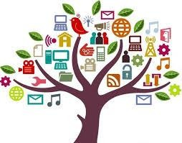

Managing the Cloud
Managing the Cloud—Customer
Provision resources in the cloud
If you are using a public or private cloud, you need a mechanism that enables you to provision new resources when you need them. Can this be automated, or does someone have to manually do it?
This administrative function includes setting up your cloud environment as well as building and deploying applications in the cloud. This administrative process will be needed regardless of whether you are using a public or a private cloud.
2. Deal with incidents and problems
When your organization begins adopting some cloud computing capabilities, you must have a plan to handle problems such as unexpected outages. Although the cloud computing vendor will have its own infrastructure and tools for this, you have to be proactive too. Know how your provider handles changes to its environment.
Depending on how critical the cloud service is to your business, you have different levels of support. For example, if you are a large corporation using a cloud service for all your company’s email services, you probably want to establish a plan with your provider for direct support to handle problems.
9

Slide 70
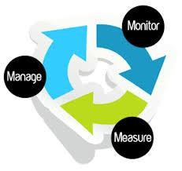

Managing the Cloud
Managing the Cloud—Customer
Monitor and measure
You really need these things overall:
A dashboard that provides you with insights across the applications and services that are running in your data center and those that are running in a cloud.
A service-level agreement across your own services and those provided by cloud providers to get a true picture of the service you are providing to your company.
Bill and other services
All cloud providers will bill your company based on one of the following:
How many users are supported?
How much capacity you use?
How many services you leverage?
9

Slide 71
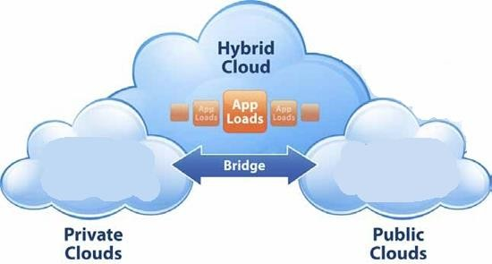
Managing the Cloud
Hybrid environments
A hybrid environment will contain a traditional data center, a private cloud, and some cloud services.
This hybrid environment requires management of both the virtual servers and the physical infrastructure beneath.
Two important capabilities need to be in place to manage this hybrid world:
The service catalog
The Configuration Management Database (CMBD).
9

Slide 72
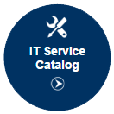
Managing the Cloud
Hybrid environments
The service catalog
One of the important factors in managing a cloud is to ensure a way to manage IT assets and activities. Defined as part of the Information Technology Infrastructure Library (ITIL) Service Design best practice, the service catalog is a component list that makes up internal and external services that are available to an organization.
A typical service catalog includes such items as the definition of the service, its service level, who is entitled to use that service, and what components are required to execute that service.
A service catalog is required for organizations to manage services in a hybrid world—across data centers, private and public clouds, as well as hosted environments.
9

Slide 73
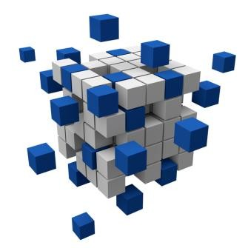
Managing the Cloud
Hybrid environments
The Configuration Management Database (CMDB)
To understand what services are being managed across your various computing environments, you should keep track of changes. That is the role of the Configuration Management Database (CMDB).
For example, many cloud environments use extensive virtualization to add efficiency. Virtualization enables the abstraction of hardware assets so that these assets can be used for multiple purposes.
These varied uses increase the difficulty of tracking changes to these resources.
It is important for the cloud provider to track these assets and understand what has been changed and what state that service is in.
9

Slide 74
Managing the Cloud
Planning for the Cloud
74

Slide 75
Managing the Cloud
Economic Cost Model
75

Slide 76
Managing the Cloud
Economic Cost Model and Leveraging the Cloud
It is hard for most organizations to accurately predict the actual costs of running any given application in the data center. A particular server may be used to support several different applications.
Consider, as a simple example, the use of email. Some departments are very heavy users, whereas others barely touch it at all. Pockets within a single department may be are heavy users. Although technically you can monitor individual use, doing so would require more overhead than its worth.
9

Slide 77
Managing the Cloud
Cloud Economics
Listing application costs
In creating an economic model of an application, determine all the costs in a way that allows you to do a fair comparison.
Server costs (A): With this and all other hardware components, you are specifically interested in the total annual cost of ownership, which normally consists the cost of hardware support plus some amortization cost for the purchase of the hardware.
Storage costs (B): In situations where a storage area network (SAN) or network attached store (NAS) is used for an application, a proportional cost over the whole SAN or NAS needs to be determined, including management and support cost for the hardware.
Network costs (C): This needs to be carefully considered because the fact that an application moves into the cloud does not necessarily mean that all the network traffic it generates disappears. For example, data may need to be pulled from the application’s database to be added to a data warehouse. Alternatively, when Web applications are moved into the cloud, corporate Internet bandwidth requirements may be are reduced. Clearly, the ability to access external applications requires substantial bandwidth.
9

Slide 78
Managing the Cloud
Cloud Economics
Backup and archive costs (D): The actual savings on backup costs depends on what the backup strategy will be when the application moves into the cloud. The same is true of archiving. Will all backup be done in the cloud? Will your organization still be required to back up a percentage of critical data?
Disaster recovery costs (E): In theory, the cloud service will have its own disaster recovery capabilities, so there may be a consequential savings on disaster recovery. However, you need to clearly understand what your cloud provider’s disaster recovery capability is. Not all cloud providers have the same definition of disaster recovery. IT management must determine the level of support the cloud provider will offer.
Data center infrastructure costs (F): A whole series of costs including electricity, floor space, cooling, building maintenance, etc. cannot easily be attributed to individual applications, but can usually be assigned on the basis of the floor space that the hardware running the application occupies. For that reason, try to calculate a floor space factor for every application.
9

Slide 79
Managing the Cloud
Cloud Economics
Platform costs (G): Some applications only run in specific operating environments—Windows, Linux, HP-UX, IBM zOS, etc. The annual maintenance costs for the application operating environment need to be known and calculated as part of the overall costs.
Software maintenance costs (package software) (H): Normally, this cost element is simple because it comes down to the software’s annual maintenance cost. However, it may be complicated if the software license is tied to processor pricing. The situation could be further complicated if the specific software license is part of a bundled deal.
Software maintenance costs (in-house software) (I): Such costs exist for all in-house software, but may not be broken out at an application level. For example, database licenses used across many different applications may be calculated at a corporate level. It may be necessary to allocate these database cost at a per-application level. There may also be these kinds of costs for packaged software if in-house components have been added or if integration components have been built to connect this application to other applications.
9

Slide 80
Managing the Cloud
Cloud Economics
Help desk support costs (J): It is necessary to analyze all help desk calls at an application level to determine the contribution of an application (if any) to help desk activity. The support costs for some applications may be anomalous and may disappear with the movement into the cloud. Some applications require more support than others. Understanding the different support requirements is the key to making the right decision on the cloud.
Operational support personnel costs (K): There is a whole set of day-to-day operational costs associated with running any application. Some are general costs that apply to every application, including staff support for everything from storage and archiving, to patch management and networks and security. Some support tasks, however, may be particular to a given application, such as database tuning and performance management.
Infrastructure software costs (L): A whole set of infrastructure management software is in use in any installation, and it has an associated cost. For example, management software is typically used for many different applications and cannot easily be divided across specific applications.
9

Slide 81
Managing the Cloud
Cloud Economics
A simple formula that states the annual data center cost of application ownership is:
Total Cost of Application Ownership (TCAO) = A + B + C + D + E + F + G + H + I + J + K + L
9

Slide 82
Managing the Cloud
Planning for Leveraging the Cloud
82

Slide 83
Managing the Cloud
Planning for Leveraging the Cloud
Moving to the cloud requires managing the IT assets in a different way than the traditional setup. Let us look at two examples that illustrate the need for proper planning so that the transition to the cloud is smooth.
Example 1
Say you are an electronics distributor who was using a CRM application that no one was particularly happy with. Fred in the camera department decides to move all of the group’s sales information to a SaaS provider. However, Jane in the printer department decides to move that same sales function for her department to another SaaS provider.
When the CEO wants to know how sales are going across the two divisions, Fred and Jane scramble to get their data integrated. This problem sounds like the problem companies have had for ages with siloed information—data from different systems isolated into different environments, making it hard to integrate and manage. The same sort of thing can happen in the cloud if your cloud provider uses a proprietary format for storing data.
9

Slide 84
Managing the Cloud
Planning for Leveraging the Cloud
Example 2
Two divisions in a company with separate IT departments decide that they want to store some of their data in the cloud. Unknown to each other, they pick the same cloud provider and negotiate separate contracts with that provider. Now the company has two contracts to manage where it could have had one (probably more favorable). This can potentially cost the company more in the long run.
9

Slide 85
Managing the Cloud
Cloud Computing Resources
85

Slide 86
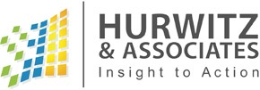
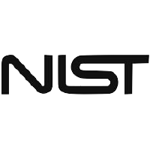
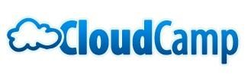
Managing the Cloud
Cloud Computing Resources
Hurwitz and Associates—blog on cloud computing.
National Institute of Standards and Technology
The National Institute of Standards and Technology (NIST) is an US government agency that focuses on emerging standards efforts. This organization has done a considerable amount of work defining and providing good information on cloud computing. Check out their Web site at http://csrc. nist.gov/groups/SNS/cloud-computing/index.html.
CloudCamp: Everyone fondly remembers fun times at summer camp. CloudCamps are not exactly the same, but they are great gatherings all over the world that bring together thinkers and doers. Check for a CloudCamp near you at www.cloudcamp.com.
4. SaaS Showplace
The SaaS Showplace was started by Jeff Kaplan, president of THINKStrategies, a SaaS consulting firm. The firm provides a constantly updated list of upcoming SaaS vendors. See a listing at www.saasshowplace.com/home.html.
9

Slide 87


Managing the Cloud
Cloud Computing Resources
TechTarget
TechTarget.com (www.techtarget.com) is a comprehensive online resource for all sorts of IT-related information, providing links to IT communities that focus on different areas of interest. SearchCloud.com, for example, is a TechTarget site with lots of information about products, services, and software vendors targeted at the needs of chief information officers and senior IT executives. Two other sites that might be useful are SearchSOA.com and SearchCompliance.com.
The Cloud Standards Wiki
This single place gives you access to lots of groups working on cloud standards. Check out their site at http://cloud-standards.org/wiki. The wiki contains information about all the organizations working in the area.
7. Finding OASIS
OASIS, the Organization for the Advancement of Structured Information Standards (www.oasis- open.org), is a global consortium focused on the creation and adoption of standards for electronic business. The consortium is a non-profit organization that relies on contributions from its member organizations. OASIS creates topic-specific committees that are beginning to focus on cloud computing.
9

Slide 88

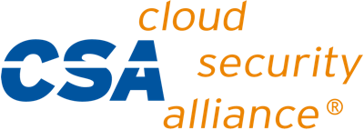
Managing the Cloud
Cloud Computing Resources
The Eclipse Foundation
The Eclipse Foundation is an open-source community focused on providing a vendor-neutral open development platform and application frameworks for building software. It is non-profit and has widespread participation from developers and corporations around the globe. The Eclipse platform is written in Java and runs on most popular operating systems, including Linux, HP-UX, AIX, Solaris, QNX, Mac OS X, and Windows. Check out the Eclipse Foundation at www.eclipse.org.
The Cloud Security Alliance
The Cloud Security Alliance was established to promote the use of best practices for providing security assurance within cloud computing, and to educate people about the uses of cloud computing to help secure all other forms of computing. Check out their Web site at www.cloudsecurityalliance.org.
9

Slide 89
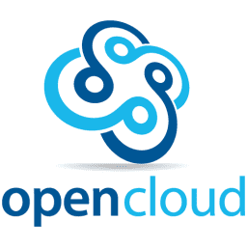
Managing the Cloud
Cloud Computing Resources
Open Cloud Manifesto
Open Cloud Manifesto is a community of more than 250 vendors intended to establish a core set of principles for cloud standards. The group has published several white papers that are worth reading. You can find them by clicking the Blogs, Wikis, and More links at www.opencloudmanifesto.org.
Vendor Sites
All the major cloud computing vendors provide great resources online. We recommend checking out vendors such as Google, VMware, EMC, Amazon, IBM, HP, Cisco, and Oracle.
9

Slide 90
Managing the Cloud
Cloud Dos and Don’ts
90

Slide 91
Managing the Cloud
Cloud Dos and Don’ts
Do not Be Reactive
Many business people who want to save money fast are tempted to throw out the data center and put all computing into a public cloud. Although this might sound good for a few hours, it is not a thoughtful approach. In the end, you might decide which capabilities you should put into the cloud, but you need to do your homework first. For example, do you have compliance issues to consider? What is the difference in cost between a public, private, hybrid, or even a traditional data center? You need to make sure that all the possible impacts have been considered before you spring into action.
Do Consider the Cloud a Financial Issue
You might start looking at some approaches to the cloud that sound really good. But before you jump in, do the math. How large is your company? What is the nature of your computing environment? How many applications do you support? How much does your current environment cost? How much spare capacity do you have in your data center? Are there applications that can cost effectively be moved to a Software as a Service model? Before you do anything, follow the money.
9

Slide 92
Managing the Cloud
Cloud Dos and Don’ts
Do not go to it Alone
Although some companies have the sophistication to build their own clouds, they have their exception. Most companies need help, so do not go into this alone. An entire industry is just waiting out there to help you. Do not ignore it. Beg, borrow, steal, but get help. Talk to your peers who have done some early
cloud projects. Consult with systems integrators, technology companies, and other consultants who have solid experience with best practices. Some cloud Web sites and organizations have great ideas and collaboration opportunities.
Do Think about Your Architecture
Just because you are thinking about moving into the cloud does not mean architecture is no longer important. In fact, it is more important than ever. You will probably have business services that are designed for reuse that should be stored in a private or public cloud that need to be designed for reuse. You will likely have a hybrid environment that needs to be well planned to conform to your company’s service-level agreement and performance requirements.
9

Slide 93
Managing the Cloud
Cloud Dos and Don’ts
Do not Neglect Governance
If you do not pay attention to compliance and governance, you are putting your company at risk. For example, some industries require that you store data in a very specific way. Some countries require that your customer data are never stored outside of its territory. You still have to comply with government regulations. These issues do not disappear into a cloud.
Do not Forget about Business Process
Start with the business process that you want to automate with your cloud initiatives. No matter which form of cloud you are considering, the process is the building block. If you have not figured out how business processes will be managed in this new distributed world, your business could be at risk.
Do Make Security the Centerpiece of Your Strategy
It is easy to get caught up in the mix-and-match euphoria and forget about the nitty–gritty issues. Pay close attention to the security implications of moving to the cloud. You still need a well-planned security strategy.
9

Slide 94
Managing the Cloud
Cloud Dos and Don’ts
Do not Apply the Cloud to Everything
Do not get carried away. Not everything belongs in a cloud. For example, your data center might have a large, complex, and customized application used by a dozen people. It is critical to your business. You have no economic or business reason to move that application to the cloud. Do your homework so you have guidelines to help you determine whether an application or a function belongs in the data center, a public cloud, or a private cloud.
Do not Forget about Service Management
It is easy to make the assumption that if something is in the cloud, you do not have to worry about managing it. Although many cloud providers allow you to have a portal view of their own service levels, it is your responsibility to keep track of any service you have put into either a public or a private cloud.
Do Start with a Pilot Project
Cloud computing will be around for a long time, so get experience now. Start with a pilot project. For example, you might want to start with a Software as a Service platform. You might use a public cloud for testing a new application before it goes into production. This gives you a feeling for what it means to give up this level of control.
9

Slide 95
Managing the Cloud
Self-Assessment Question
Measuring the quality of a cloud provider’s approach to security is:
Clear and easy because all cloud providers are required to disclose it publicly.
Difficult because many cloud providers do not expose their infrastructure to customers.
Answer: B

Slide 96
Managing the Cloud
Self-Assessment Question
protect the internal network from the Internet, whereas protect external connections coming into the network.
Firewalls and VPNs
Firewalls and Antivirus
VPNs and Firewalls
VPNs and Antivirus
Answer: A

Slide 97
Managing the Cloud
Self-Assessment Question
The primary goal of Identity management is managing so that access to computer resources, applications, data, and services is controlled properly.
Logs
Applications
Personal identity information
None of the above
Answer: C

Slide 98
Managing the Cloud
Self-Assessment Question
Identity management system should have a direct interface with customer databases.
Yes
No
Answer: A

Slide 99
Managing the Cloud
Self-Assessment Question
Single sign on means:
An interface that validates identity as soon as a user signs on anywhere.
Sign on once and stay logged in forever.
Sign on expires after an hour
None
Answer: A

Slide 100
Managing the Cloud
Self-Assessment Question
Activity logs and data audit are products.
Data protection
Data Portability
Detection and Forensics
Identity management
Answer: C

Slide 101
Managing the Cloud
Self-Assessment Question
HIPS and NIPS stand for:
Host-based intrusion protection systems and network-based intrusion protection systems.
Hardware-based intrusion protection systems and network-based intrusion protection systems.
Answer: B

Slide 102
Managing the Cloud
Self-Assessment Question
means that software is put in a separate container so that it is isolated from operating systems.
Removing
Separating
Decoupling
Isolating
Answer: C

Slide 103
Managing the Cloud
Self-Assessment Question
Many license agreements tie license fees to physical servers rather than to virtual servers.
True
False
Answer: A

Slide 104
Managing the Cloud
Self-Assessment Question
Clustering, or grouping, of virtual machines across different physical servers
Provisioning Hardware
Provisioning Software
Answer: B

Slide 105
Managing the Cloud
Self-Assessment Question
Hardware provisioning is:
Migration of running virtual machines from one physical server to another
Automatic restart of a failed virtual machine on a separate physical server
The act of allocating a virtual machine to a specific server from a central console.
Clustering, or grouping, of virtual machines across different physical servers
Answer: C

Slide 106
Managing the Cloud
Self-Assessment Question
The security issues faced while managing virtualization is:
Physical theft
Attack on the hypervisor
Answer: B

Slide 107
Managing the Cloud
Self-Assessment Question
The responsibility of cloud security lies with:
Provider only
Customer only
Both provider and customer
None
Answer: C

Slide 108
Managing the Cloud
Self-Assessment Question
Select the option that is NOT the responsibility of the cloud vendor:
Authenticate all users
Ensure thorough background checks of all employees who have physical access to the servers
Ensure data isolation and logical storage segregation
Manage and secure the virtualization layer
Answer: A

Slide 109
Managing the Cloud
Self-Assessment Question
Data can be encrypted:
At rest as well as when in transit over the network.
Only when in transit over the network.
Only when at rest.
While storing on an external device.
Answer: A

Slide 110
Managing the Cloud
Self-Assessment Question
In a virtualized desktop, the applications, data, files, and anything graphic are:
Separated from the actual desktop and stored on a server in a data center.
Are separated from the actual desktop and stored an external hard disk.
Answer: A

Slide 111
Managing the Cloud
Self-Assessment Question
Client virtualization involves emulating on a data center server and displaying the user interface on a graphics terminal.
An entire application
A whole PC in software
The file system
Main memory
Answer: B

Slide 112
Managing the Cloud
Self-Assessment Question
A server blade is a server computer contained entirely on a single computer board that can be slotted into a blade cabinet.
True
False
Answer: A

Slide 113
Managing the Cloud
Self-Assessment Question
Desktone platform is:
A desktop virtualization platform
A platform for managing operating systems
Answer: A

Slide 114
Managing the Cloud
Self-Assessment Question
A service-oriented architecture is:
A collection of random services.
A collection of services which communicate with each other.
Answer: A

Slide 115
Managing the Cloud
Self-Assessment Question
Service-oriented approach is used to design software that:
Reflects best practices and business practices
Creates a purely technical environment for the business to run on.
Answer: A

Slide 116
Managing the Cloud
Self-Assessment Question
SOA is:
White-box component architecture.
Glass-box component architecture.
Black-box component architecture.
Green-box component architecture.
Answer: C

Slide 117
Managing the Cloud
Self-Assessment Question
The is used to pass messages between the components of an SOA implementation.
SOA Registry
Business Process Manager
Service Broker
Enterprise Service Bus
Answer: D

Slide 118
Managing the Cloud
Self-Assessment Question
The SOA Registry contains information about:
The business processes
Location of the SOA services
Answer: B

Slide 119
Managing the Cloud
Self-Assessment Question
A is a component list that makes up internal and external services that are available to an organization.
SOA
Service manager
Service catalog
SRS
Answer: C

Slide 120
Managing the Cloud
Assignment
You need to answer below sets of problem. These sets of questions are meant for testing unit IV.
Elaborate categories under which the cloud security products fall.
Discuss managing virtualization in cloud.
Explain virtual desktops and their management in cloud.
Explain how Service-Oriented Architecture helps cloud.
Examine cloud management from the point of view of both the customer and service provider.
Explain service catalog and CMDB.
Explain the costs that should be determined when creating an economic cost model.
Describe any five cloud computing resources.
Outline the Cloud Dos and Don’ts.

Slide 121
Introduction to Operating System
Summary
An IT organization must ensure the right balance of protection, privacy, governance, and accessibility to key resources— whether in the traditional data center, the private cloud, or the public cloud.
Identity management’s primary goal is managing personal identity information so that access to computer resources,
applications, data, and services is controlled properly.
Single sign-on means providing all users an interface that validates identity as soon as a user signs on anywhere; this interface requires the user to enter a single password. Thereafter, all systems should know the user and her permissions.
Host-based intrusion protection systems (HIPS) and network-based intrusion protection systems (NIPS) are the same thing: a collection of capabilities that make it tough to penetrate a network.
Data can be encrypted at rest as well as when in transit over the network reducing the risk of hackers stealing the data.
Virtualization decouples the software from the hardware. Decoupling means that the software is put in a separate container so that it is isolated from operating systems.
Provisioning software allows to create new virtual machines and modify existing ones to add or reduce resources. It enables the management to prioritize actions based on company’s key performance indicators.
When virtual machines are not in use, they are stored as disk files that can be instantiated at a moment’s notice.
In a virtualized desktop, the applications, data, files, and anything graphic are separated from the actual desktop and stored on a server in a data center (not on the individual machine). A virtual desktop is also called graphic terminal or a thin client.
A server blade is a server computer contained entirely on a single computer board that can be slotted into a blade cabinet—a purpose-built computer cabinet with a built-in power supply. The server blade can contain a number of PC blades.
A service-oriented architecture is essentially a collection of services. These services communicate with each other. The communication can involve either simple data passing or it could involve two or more services coordinating some activity.

Slide 122
Managing the Cloud
Document Links
Topics | URL | Notes
Managing Cloud Services | https://searchcloudcomputing.techtarget.com/t utorial/Managing-and-monitoring-cloud- computing-services | This link explains managing and monitoring cloud computing services
Virtualization and the Cloud | https://www.javatpoint.com/virtualization-in- cloud-computing | This link discusses vitualization in cloud computimg
SOA and Cloud computing | https://www.service- architecture.com/articles/cloud- computing/service- oriented_architecture_soa_and_cloud_computing. html | The link explains the Service-Oriented Architecture and its how it can be used for cloud computing.
Managing the Cloud environment | http://www.dummies.com/programming/cloud- computing/managing-cloud-computing-resources/ | The link discusses managing of cloud computing resources
Economic Cost Model | http://www.dummies.com/programming/cloud- computing/cloud-computing-economics/how-to- create-an-economic-model-of-a-data-center-in- cloud-computing/ | The link explains how to create an economic model of a data center in cloud computing.
Cloud Computing Resources | http://www.dummies.com/programming/cloud- computing/10-great-cloud-computing-resources/ | This link discusses some good cloud computing resources.
Cloud Do’s and Don’ts | https://www.ignitealliance.com.au/blog/practical- cloud-computing | The link outlines the do’s and don’ts of cloud computing.

Slide 123
Managing the Cloud
Video Links
Topics | URL | Notes
Managing Cloud Services | https://www.youtube.com/watch?v=CZVOVkmc Y2E | This video
Virtualization and the Cloud | https://www.youtube.com/watch?v=l0DfHUWM jsU | This link discusses vitualization in cloud computimg
SOA and Cloud computing | https://www.youtube.com/watch?v=4kdHJFdxotM | The link explains the Service-Oriented Architecture and its how it can be used for cloud computing.
Economic Cost Model | https://www.youtube.com/watch?v=NAwhlKkVV7 U | The link explains how to create an economic model of a data center in cloud computing.
Cloud Do’s and Don’ts | https://www.youtube.com/watch?v=kBi6_314rZM | The link outlines the do’s and don’ts of cloud computing.

